Slide 1
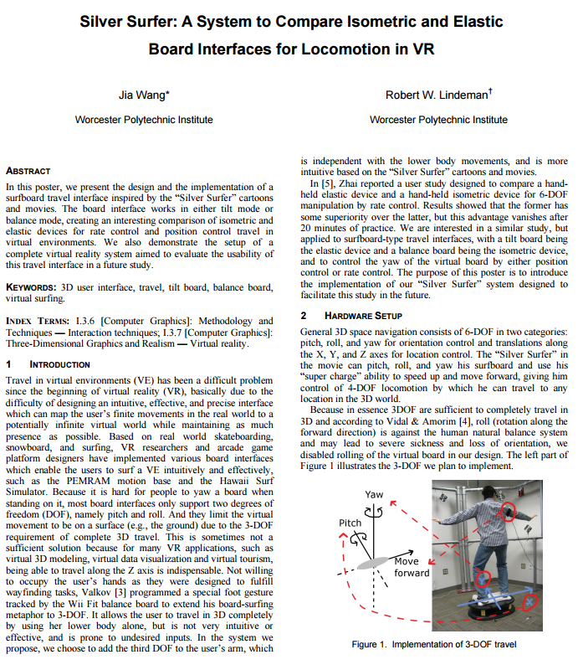
Notes:
1

Slide 2
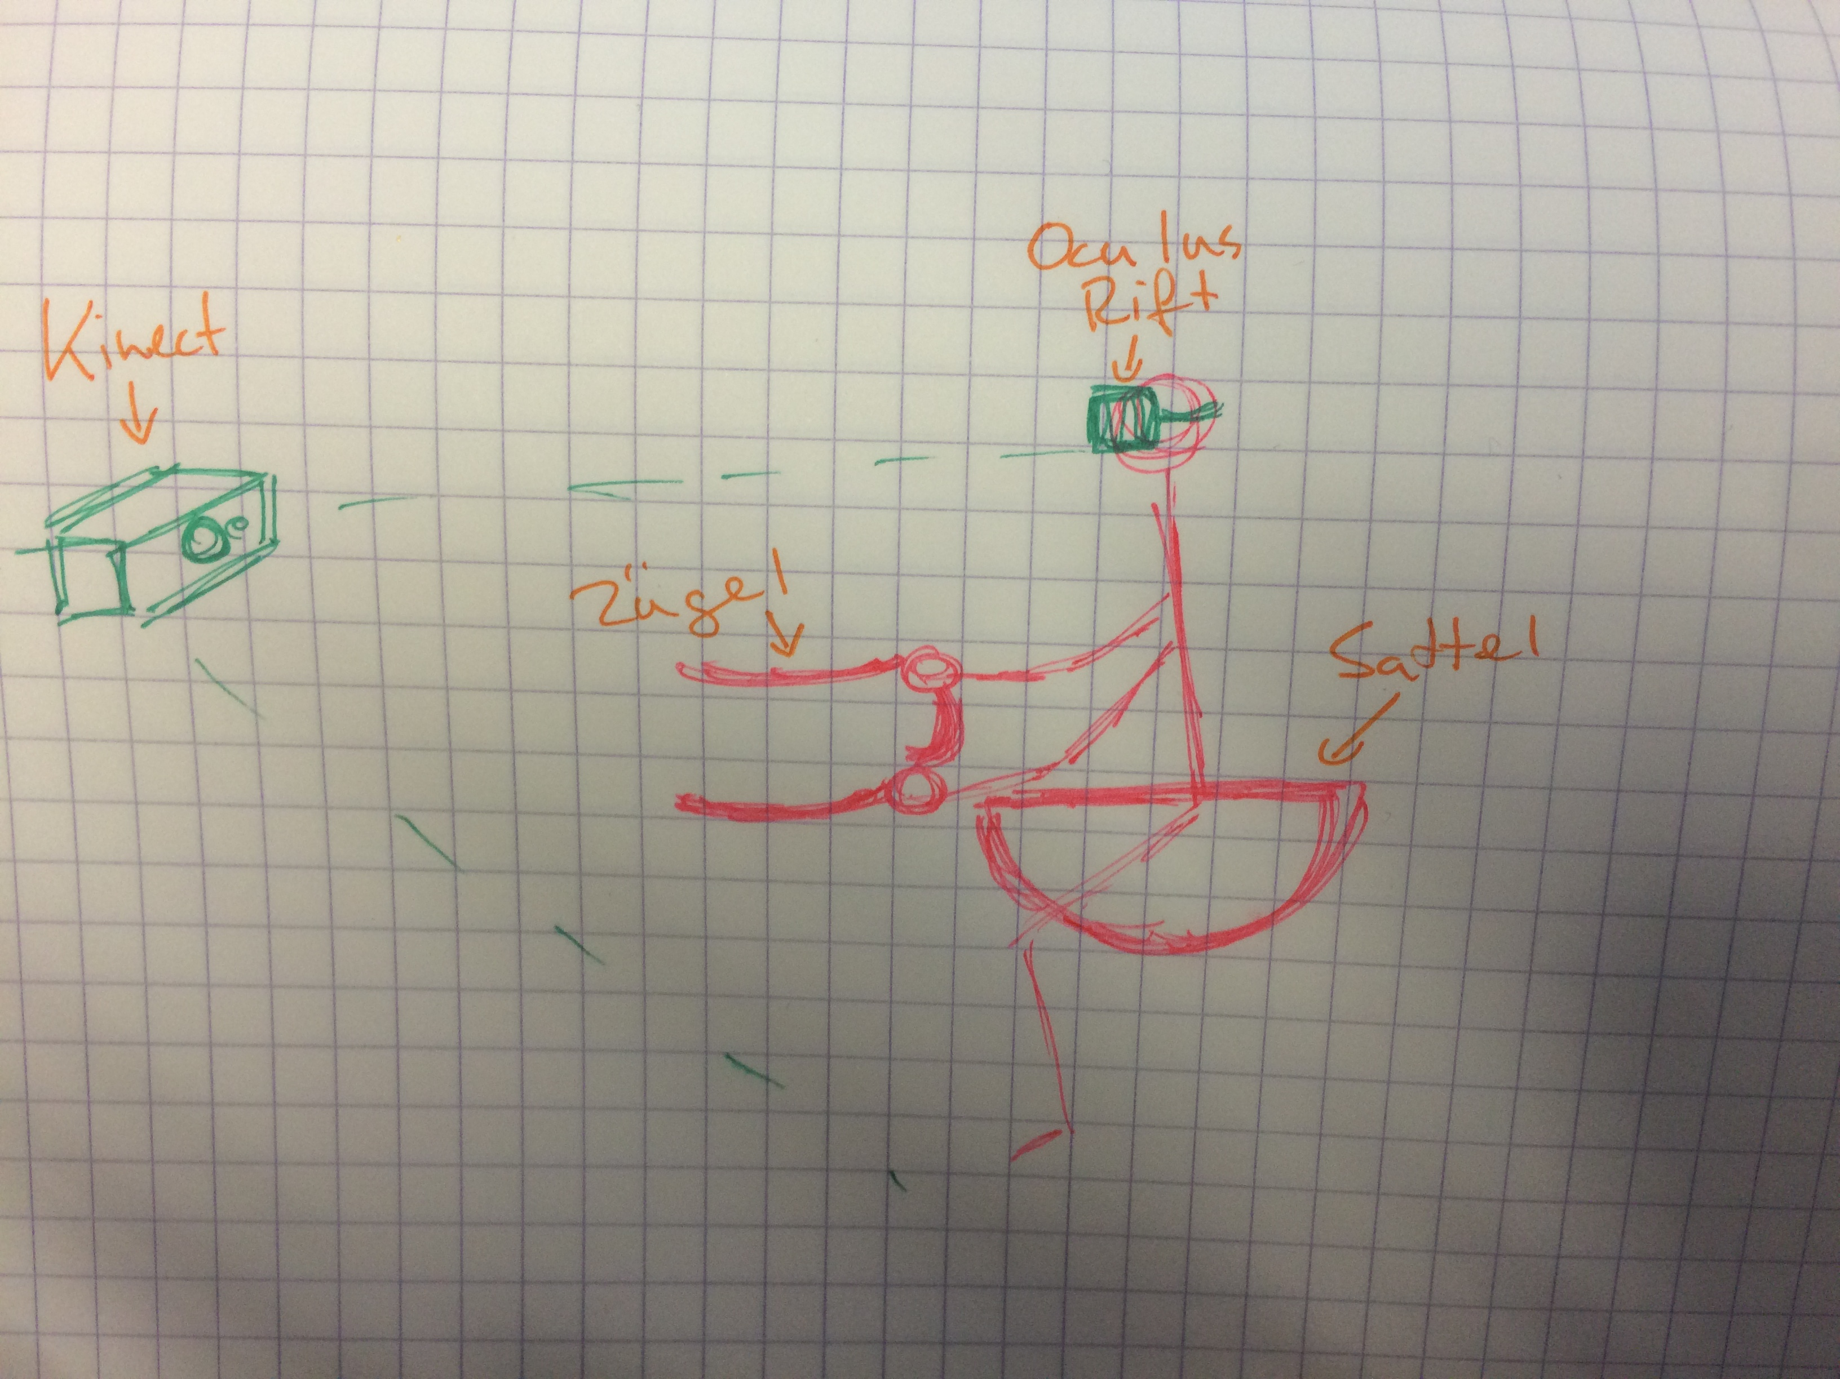
Notes:
2

Slide 3
Geste LeanForwardBackward Video
Notes:
3

Slide 4
Geste LeanLeftRight Video
Notes:
4

Slide 5
Geste Slower Faster Video
Notes:
5

Slide 6
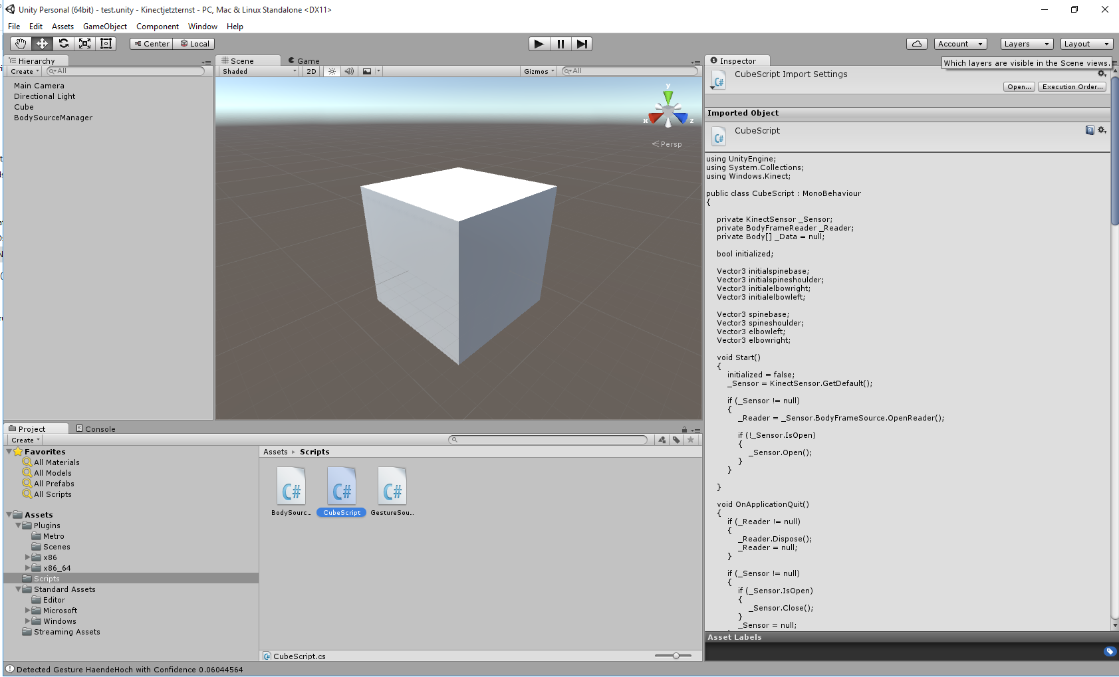
Notes:
6

Slide 7
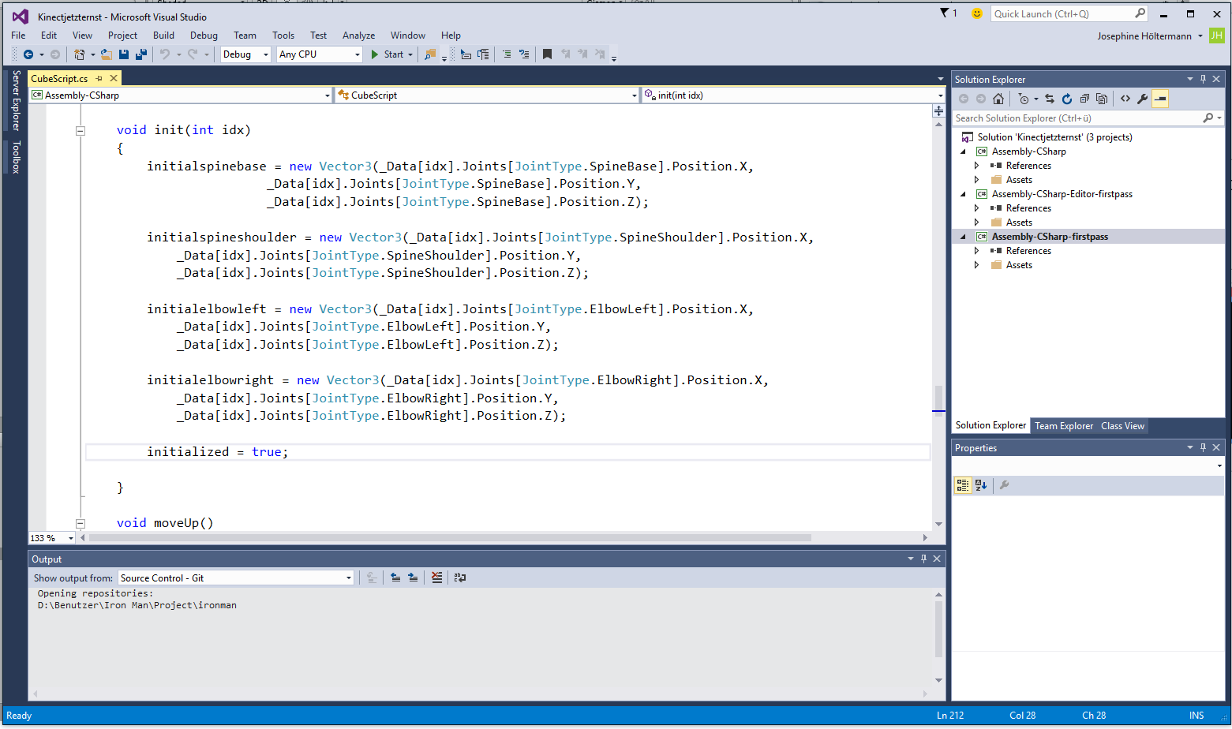
Notes:
7

Slide 8
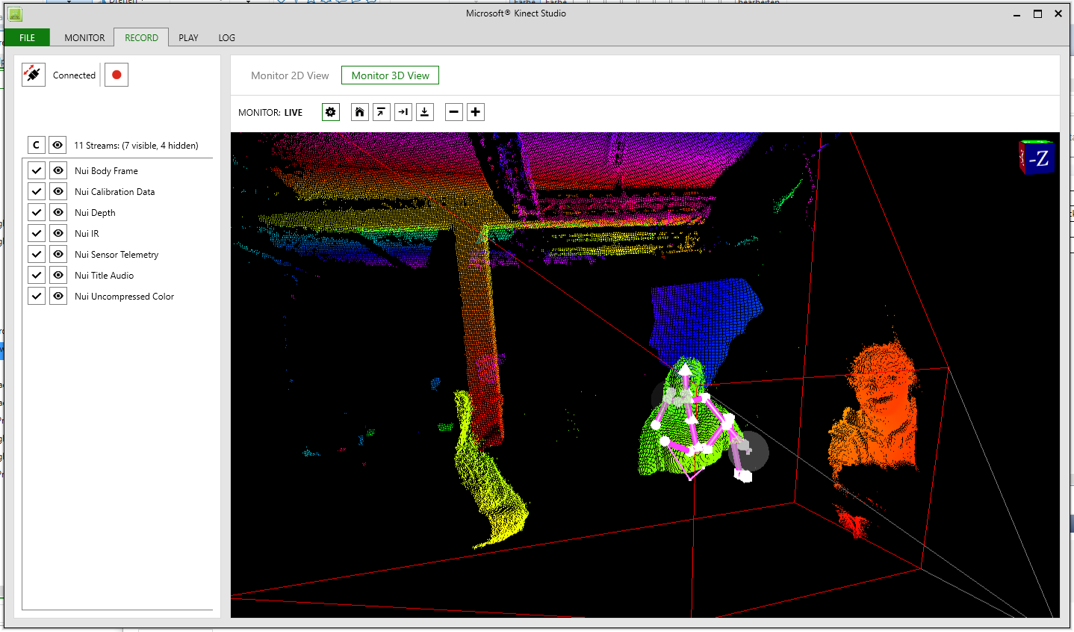
Notes:
8

Slide 9
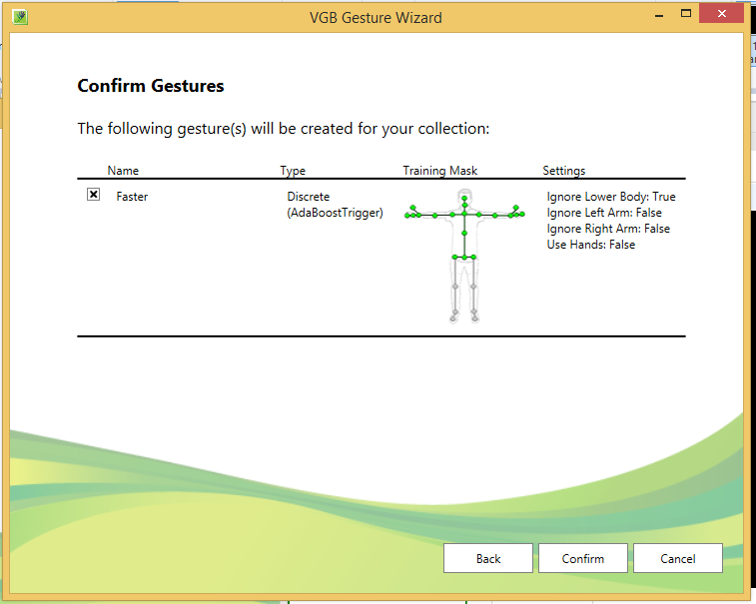
Notes:
9

Slide 10
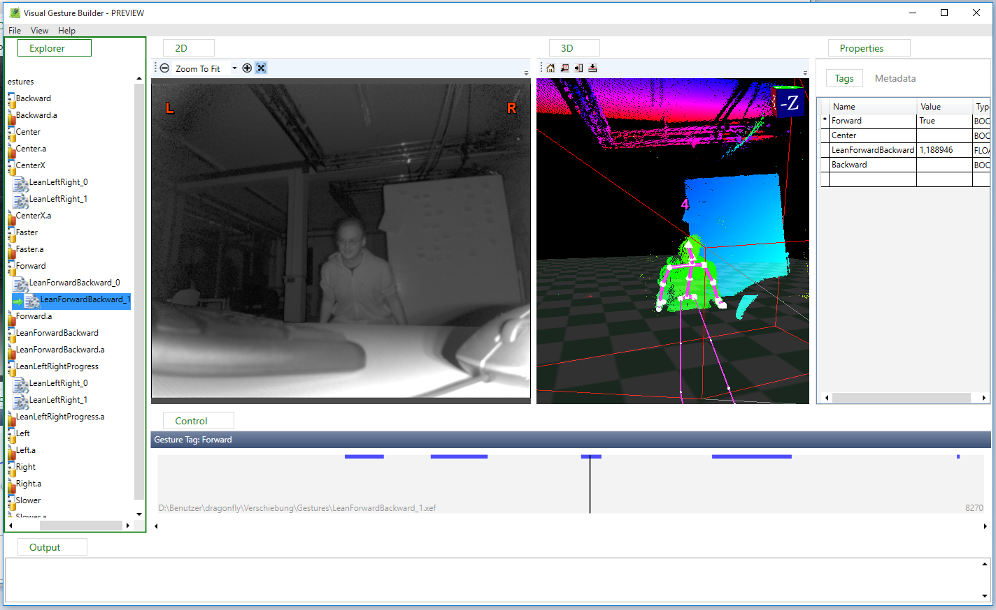
Notes:
10

Slide 11
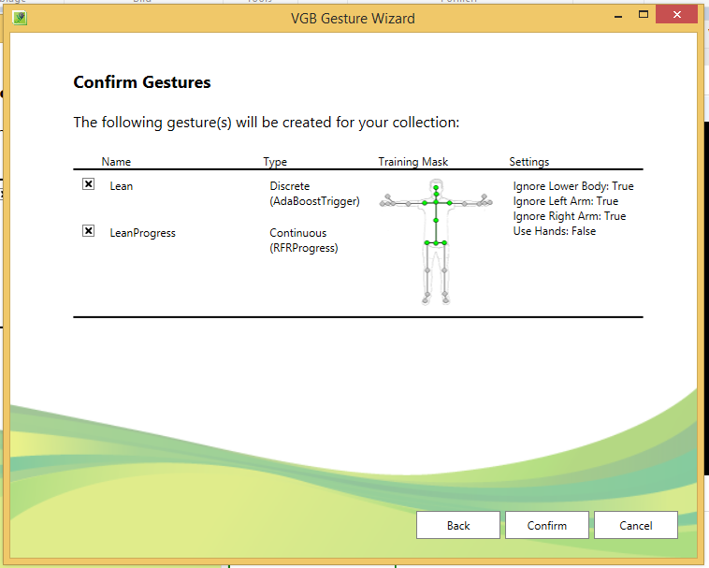
Notes:
11

Slide 12
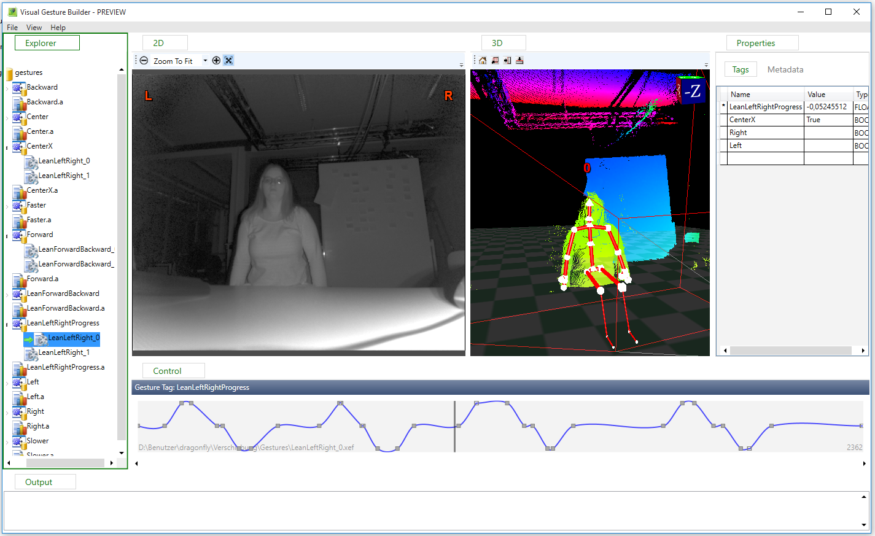
Notes:
12

Slide 13
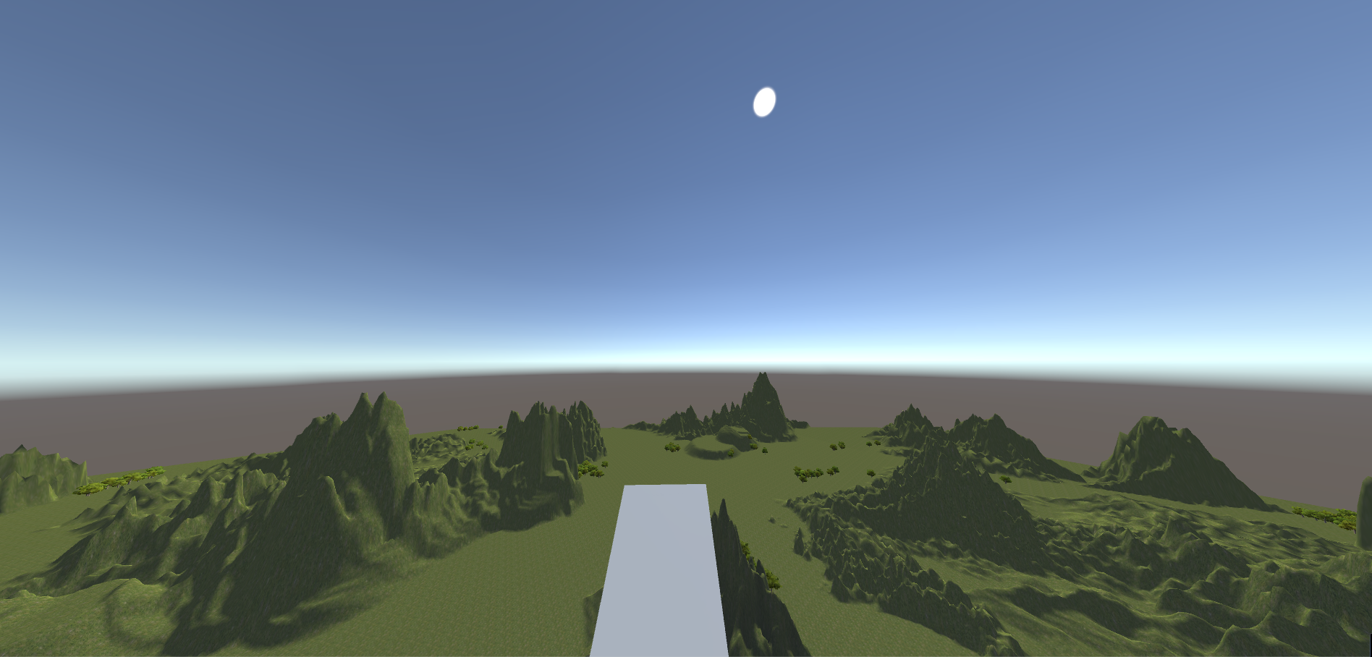
Notes:
13

Slide 14
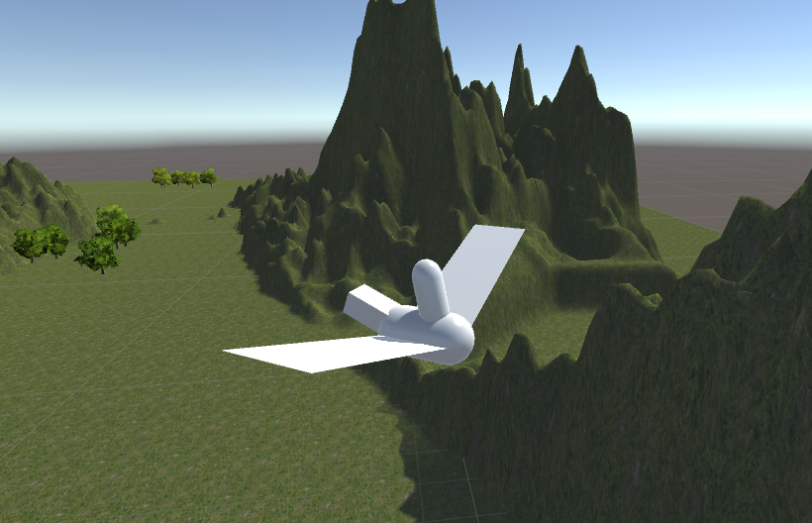
Notes:
14

Slide 15
Videodemo Oculus-Kinect
Notes:
15

Slide 16
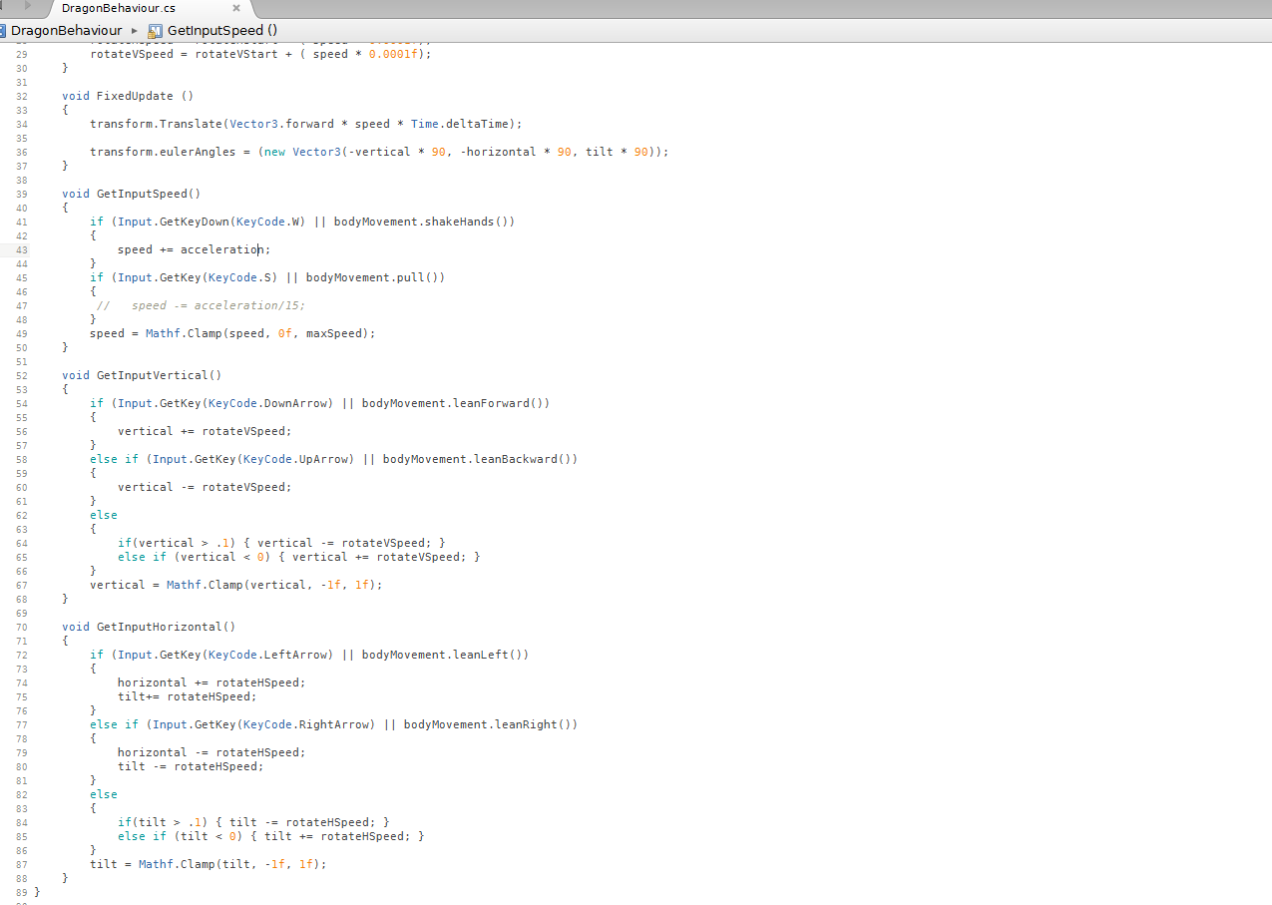
Notes:
16

Slide 17
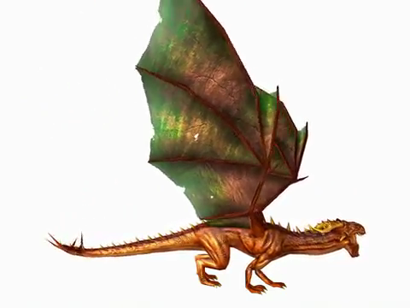
Notes:
17

Slide 18
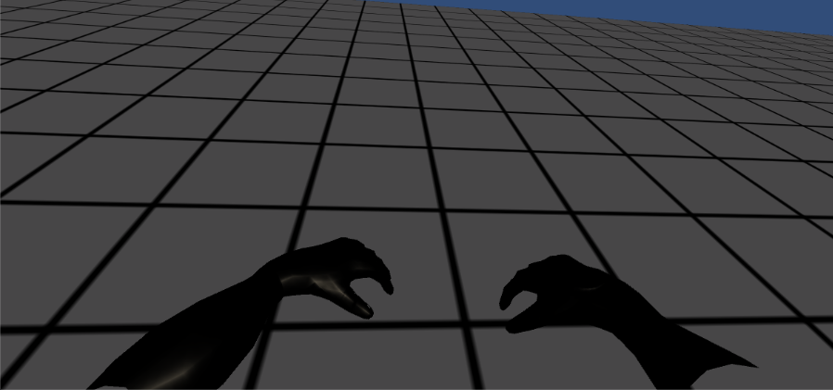
Notes:
18

Slide 19
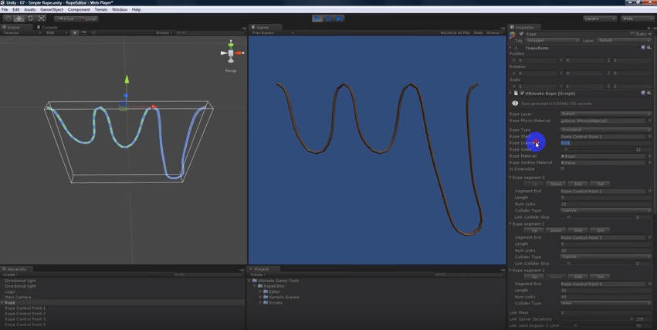
Notes:
19

Slide 20
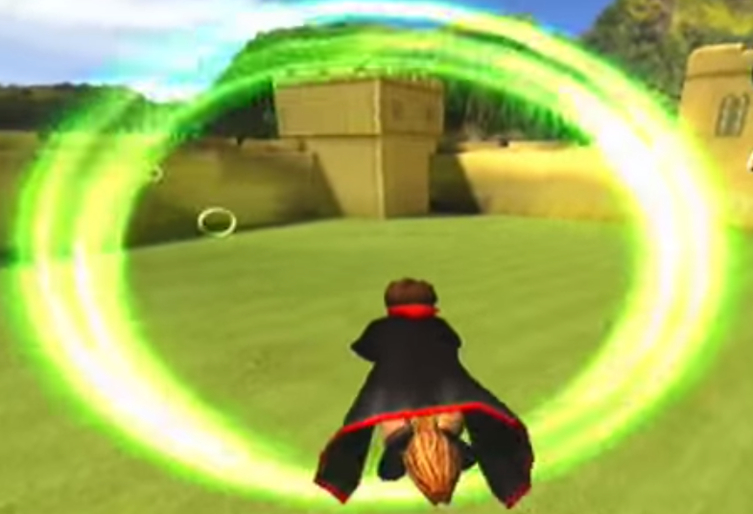
Notes:
20

